Slide 1


CS - 677 (A3) DATA SCIENCE WITH PYTHON
Project On :-
Flight Price Prediction
Pratyush Patel
12/06/23

Slide 2

INTRODUCTION
This project focuses on creating a Flight Price Prediction system using machine learning and historical flight data.
Project goal is to develop a model that accurately estimates airline ticket prices, empowering travelers to make informed decisions and better plan their trips. By analyzing various factors, such as locations, airlines, and departure times, the aim is to provide a reliable tool for predicting fluctuations in ticket prices.

Slide 3
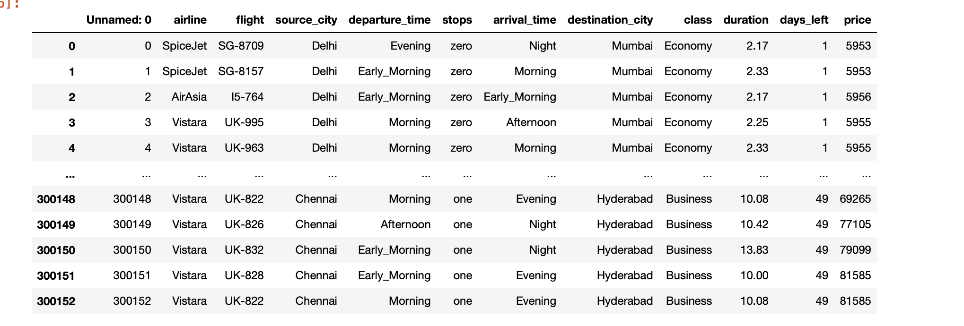

Dataset Description and Visualization

Slide 4
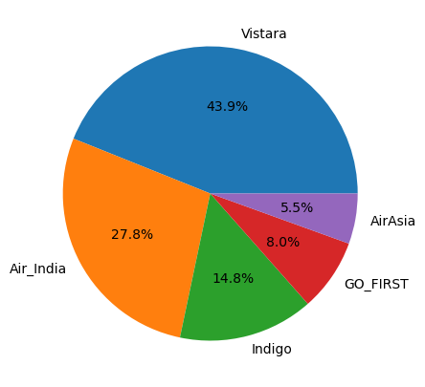
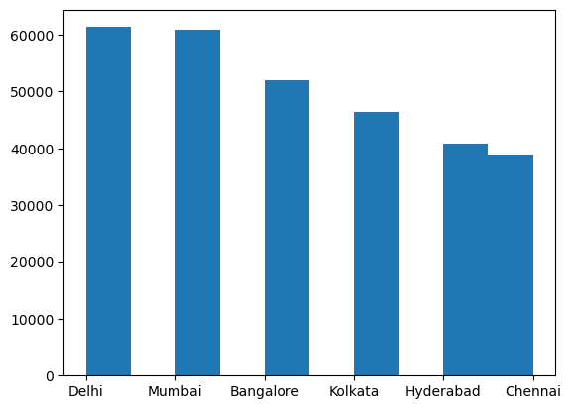
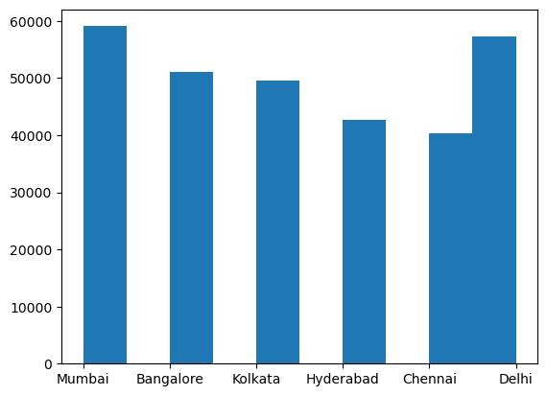
Dataset Description and Visualization

Slide 5
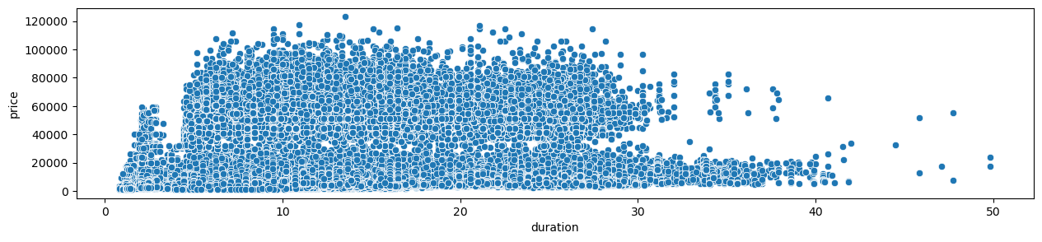
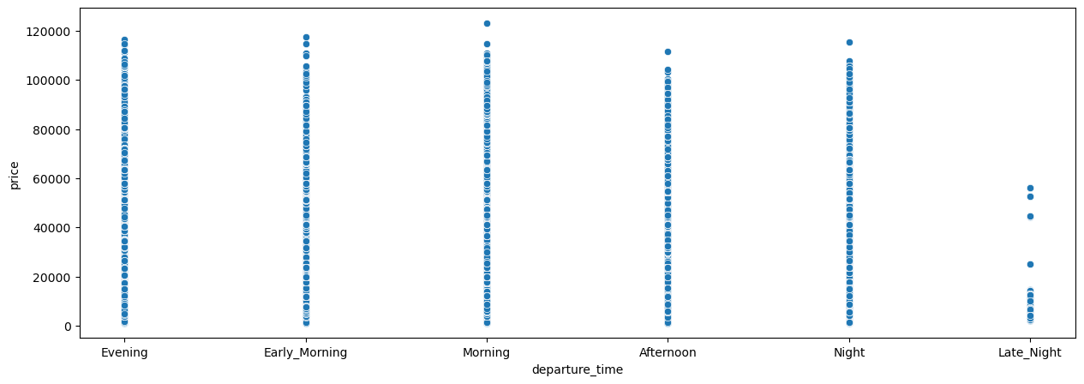
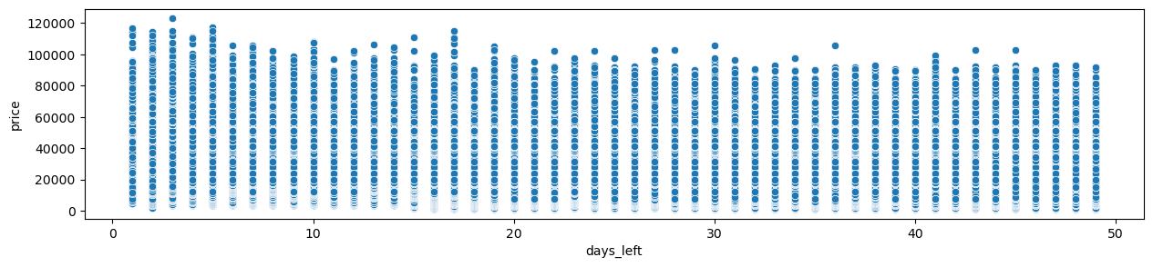
Factors affecting the prices of flight

Slide 6
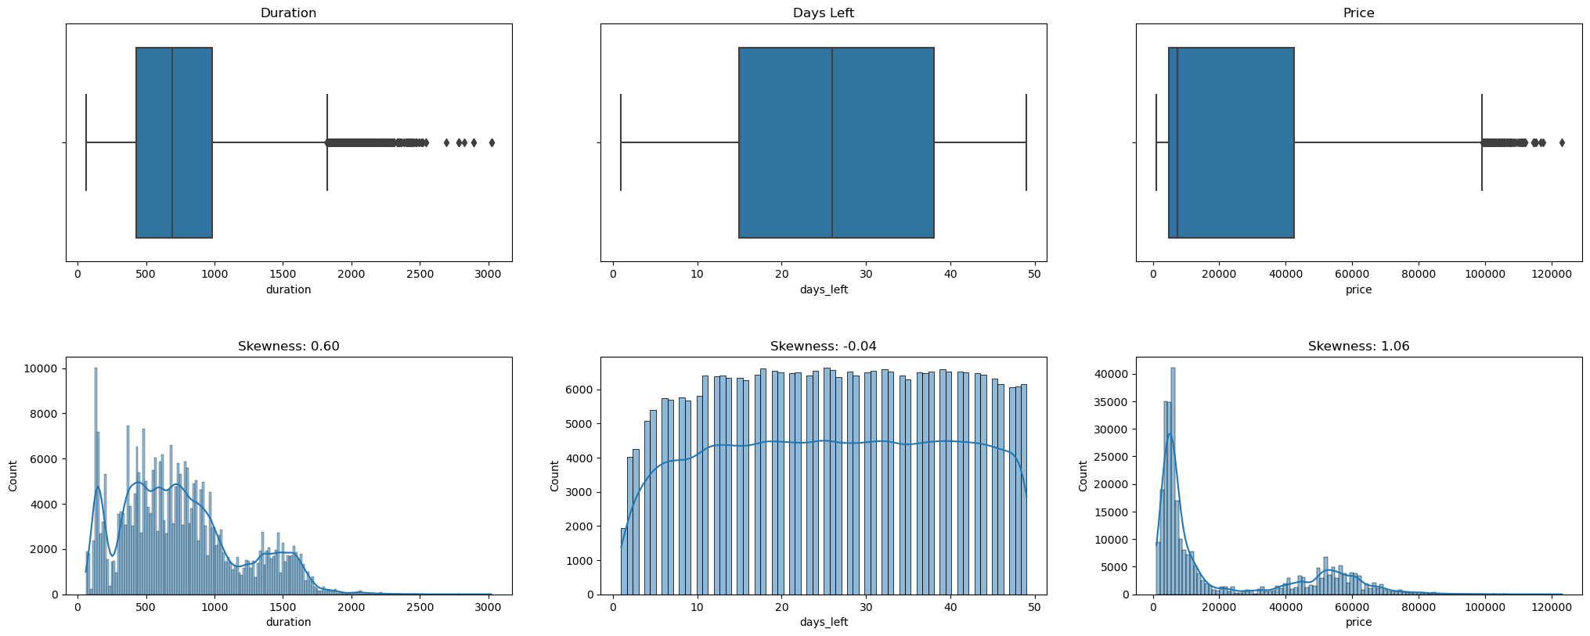
Factors affecting the prices

Slide 7
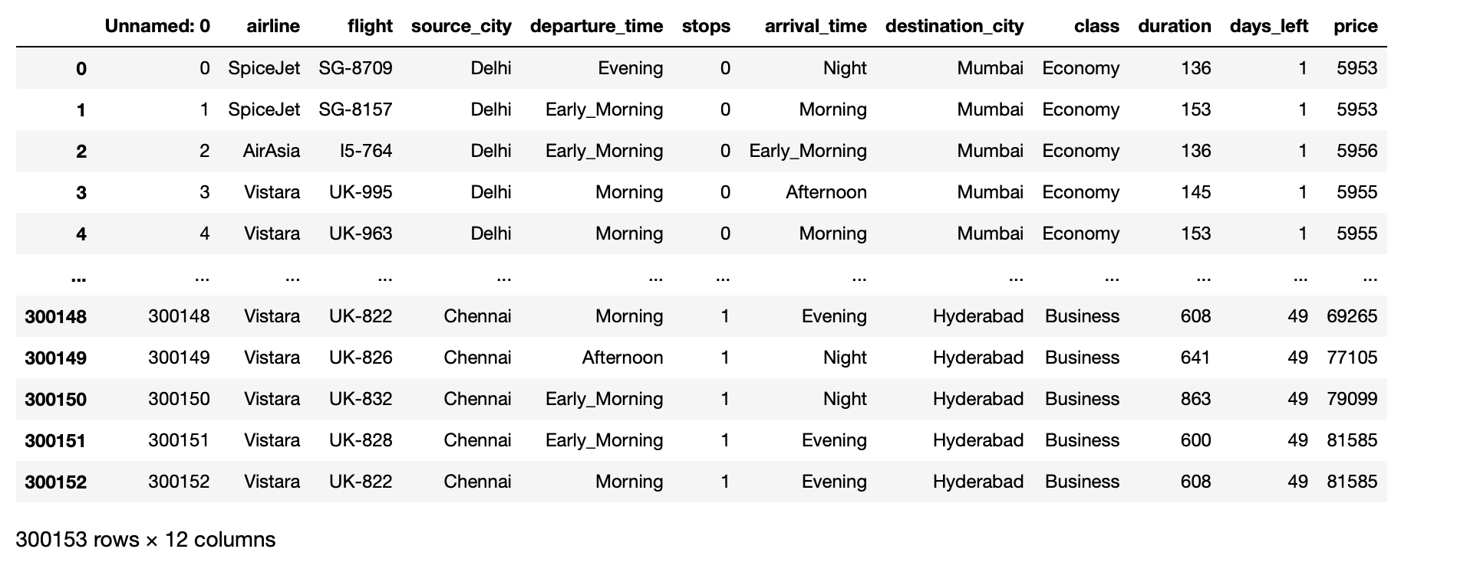
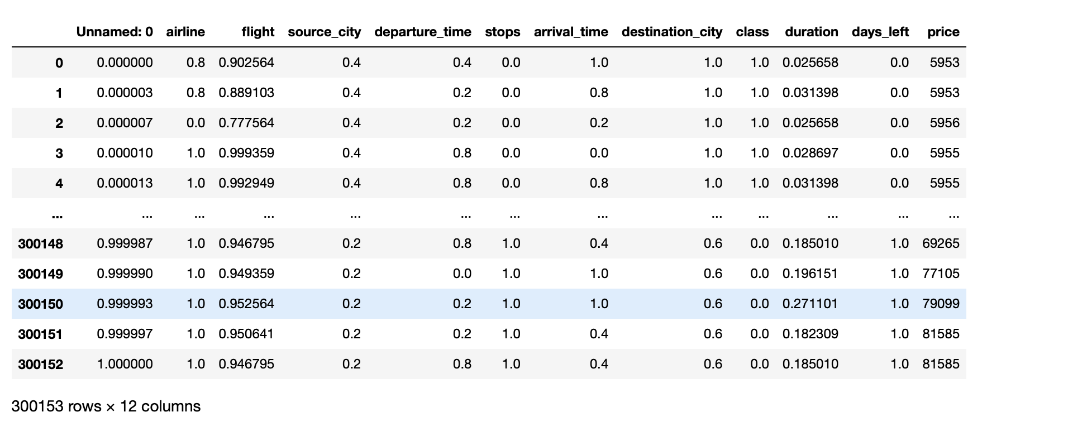
Data Transformation

Slide 8
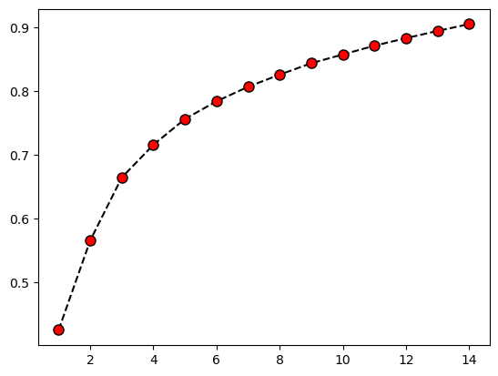
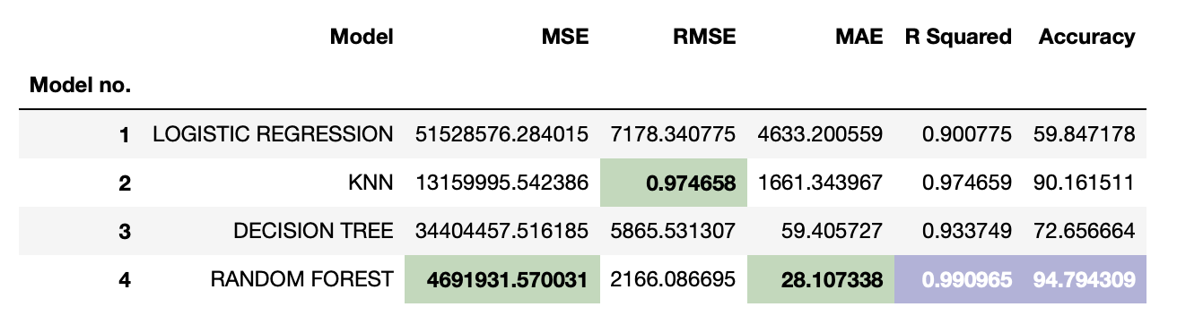
Models used for predicting the price
Logistic Regression
K Nearest Neighbors
Decision Tree
Random Forest

Slide 9
Conclusion
Among the models evaluated, the Random Forest model (Model 4) outperforms the others, demonstrating the highest accuracy and the lowest error metrics.
The KNN model (Model 2) also performs well, providing high accuracy and low error metrics.
The Linear Regression model (Model 1) and Decision Tree model (Model 3) show reasonable performance but with some limitations, especially in terms of accuracy.
Depending on your specific requirements and trade-offs, I can choose the Random Forest or KNN model for flight price prediction due to their overall better performance in this evaluation.
Overall, this project provides valuable insights into the applicability of different machine learning models for flight price prediction, offering a foundation for further refinement and optimization in future implementations.

Slide 10
THANK YOU!

